Slide 1
Computer Science
Proving Theorems
Samuel Lukas

Slide 2
Introduction
The theorems are not to find a discrete formulas but to prove the discrete formulas without knowing how to get the formulas
They are four alternatives :
Direct and indirect proving
Mathematical induction
Contradiction
Proving by Cases

Slide 3
Direct Proving
An implication p→q can be proved by showing that if p is true, then q is also true.
Prove : If n is odd then n² is odd
Assume : n is odd then n = 2k + 1, k integer
Consequently, n² = (2k + 1)²
= 4k² + 4k + 1
= 2(2k² + 2k) + 1
Since n² can be written in this form, then it is odd.

Slide 4
Indirect Proving
An implication p→q is equivalent to its contra-positive ¬q → ¬p. Therefore, we can prove p→q by showing that whenever q is false, then p is also false.
Prove : If 3n + 2 is odd, then n is odd
Assume n is not odd. It means even then n = 2k, k integer.
Consequently: 3n + 2 = 3(2k) + 2 = 6k + 2 = 2(3k + 1)
Therefore, 3n + 2 is even. It means its odd
We have shown that the contrapositive of the implication is true, so the implication itself is also true.

Slide 5
Mathematical Induction
Some examples
Prove :
The concepts :
Showing that for a certain n, n = 1, the formula is correct.
Assume that the formula is fit for n = k
Prove that for n = k+1 is also fits

Slide 6
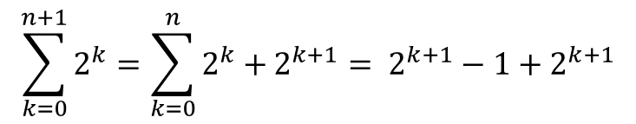
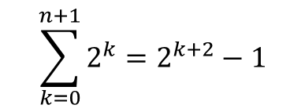
Example 01
Proving :
For n =1 then $2^{n+1}−1=1$ → it is correct to the formula
Assume that n = k then
$$\sum_{k=0}^{n+1}{2^{k}=2^{k+2}−1}$$
For : n = k+1, it is going to be proven that
$$\sum_{k=0}^{n+1}{2^{k}=\sum_{k=0}^{n}{2^{k}+}2^{k+1}= 2^{k+1}−1+2^{k+1}}$$
Proven !

Slide 7
Contradiction Theorem
This theorem is applied if direct or indirect proving does not work neither the induction of mathematics theorem.
Assuming that the proposition is not true.
Prove that the assumption of the proposition is not true because it happens contradiction proposition.
Then the assumption should be true.

Slide 8

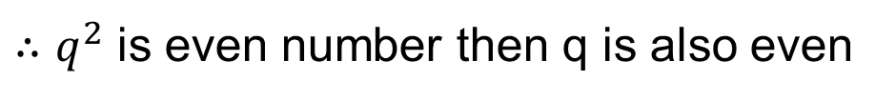

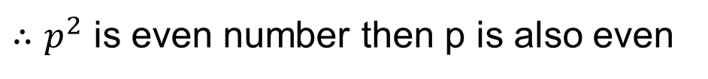
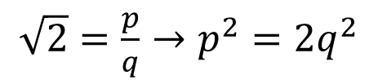
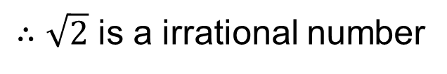
Example 02
Example : Prove that $\sqrt{2}$ is a irrational number
assuming $\sqrt{2}$ is not a irrational number but a rational number
$\sqrt{2}=\frac{p}{q}→p^{2}=2q^{2}$
${∴p}^{2}$ is even number then p is also even
$p=2a→q^{2}=2a^{2}$
${∴q}^{2}$ is even number then q is also even
Then there is at least a factor between p and q that is 2. this is contradiction with the assumption that $\sqrt{2}=\frac{p}{q}$
$∴\sqrt{2}$ is a irrational number

Slide 9

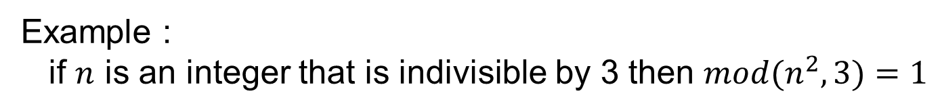
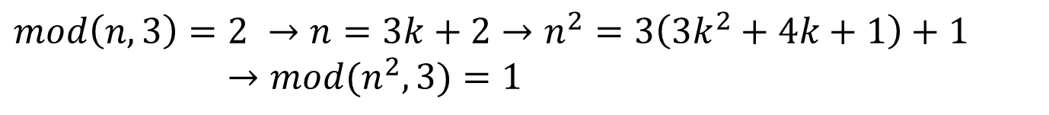
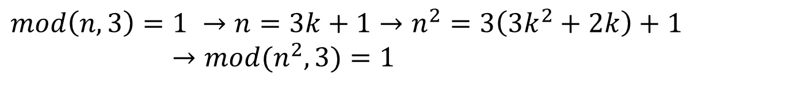
Proving by Cases
Example :
if $n$ is an integer that is indivisible by 3 then $mod{(n}^{2},3)=1$
$$\left(mod\left(n,3\right)=1 \text{or} mod(n,3)=2\right)→mod(n^{2},3)=1$$
$$mod\left(n,3\right)=1 →n=3k+1→n^{2}=3\left(3k^{2}+2k\right)+1$$
$→mod(n^{2},3)=1$
$$mod\left(n,3\right)=2 →n=3k+2→n^{2}=3\left(3k^{2}+4k+1\right)+1$$
$→mod(n^{2},3)=1$
$∴$if $n$ is an integer that is indivisible by 3 then $mod{(n}^{2},3)=1$

